Slide 1
LECTURE -5

Slide 2
INTERPOLATION

Slide 3
INTRODUCTION

Slide 4
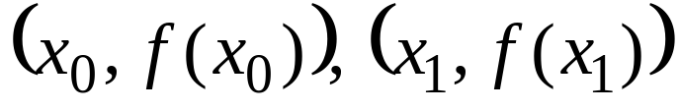
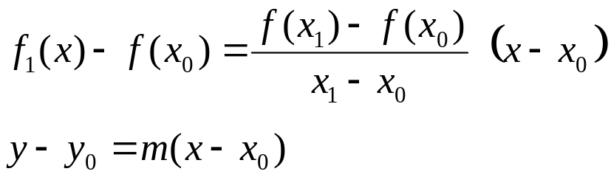
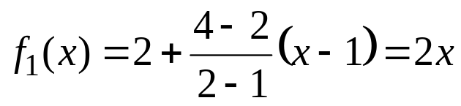
Linear Interpolation
Given any two points,
The line that interpolates the two points is
Example :
find a polynomial that interpolates (1,2) and (2,4)

Slide 5
Introduction
Interpolation was used for long time to provide an estimate of a tabulated function at values that are not available in the table.
What is sin (0.15)?
x | sin(x)
0 | 0.0000
0.1 | 0.0998
0.2 | 0.1987
0.3 | 0.2955
0.4 | 0.3894
Using Linear Interpolation sin (0.15) ≈ 0.1493
True value( 4 decimal digits) sin (0.15) = 0.1494

Slide 6
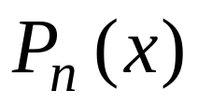
The interpolation Problem
Given a set of n+1 points,
and to find an n^{th} order polynomial
that passes through all points

Slide 7
Example
An experiment is used to determine the viscosity of water as a function of temperature. The following table is generated
Problem: Estimate the viscosity when the temperature is 8 degrees.
Temperature (degree) | Viscosity
0 | 1.792
5 | 1.519
10 | 1.308
15 | 1.140

Slide 8
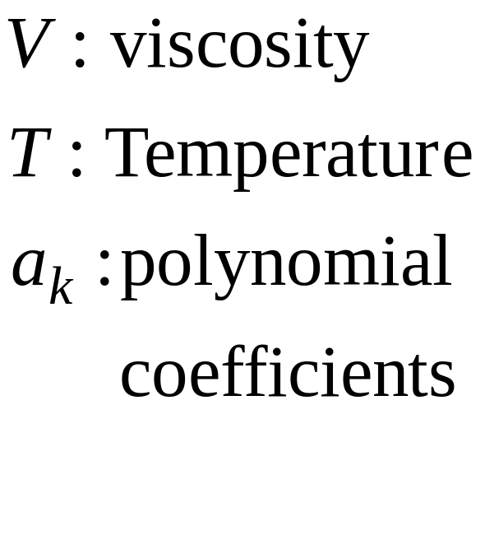
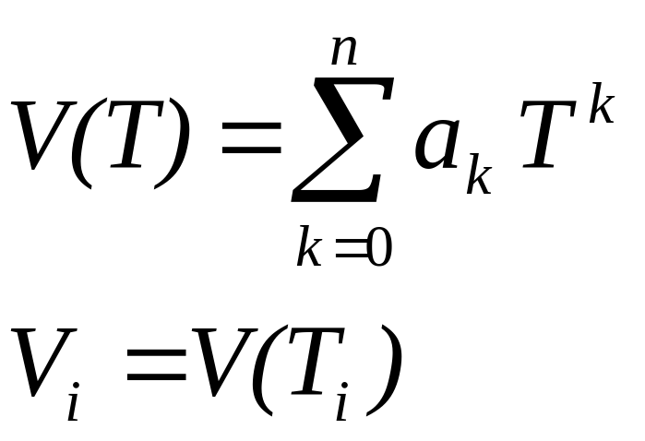
Interpolation Problem
Find a polynomial that fit the data points exactly.
Linear Interpolation V(T)= 1.73 − 0.0422 T
V(8)= 1.3924

Slide 9
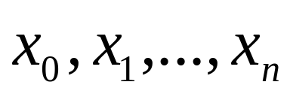
Existence and Uniqueness
Given a set of n+1 points
Assumption are distinct
Theorem:
There is a unique polynomial P_{n}(x) of order ≤ n such that

Slide 10
Examples of Polynomial Interpolation
Linear Interpolation
Given any two points, there is one polynomial of order 1 that passes through the two points.
Quadratic Interpolation
Given any three points there is one polynomial of order 2 that passes through the three points.

Slide 11
Lagrange Interpolation

Slide 12





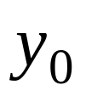


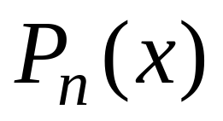
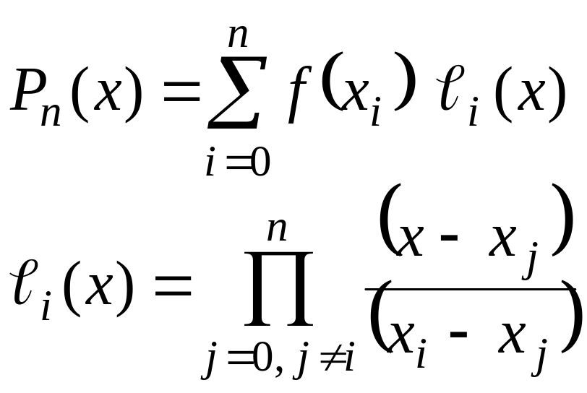
Lagrange Interpolation
Problem:
Given
Find the polynomial of least order such that
Lagrange Interpolation Formula
 |  |  | ….
 |  |  | ….

Slide 13
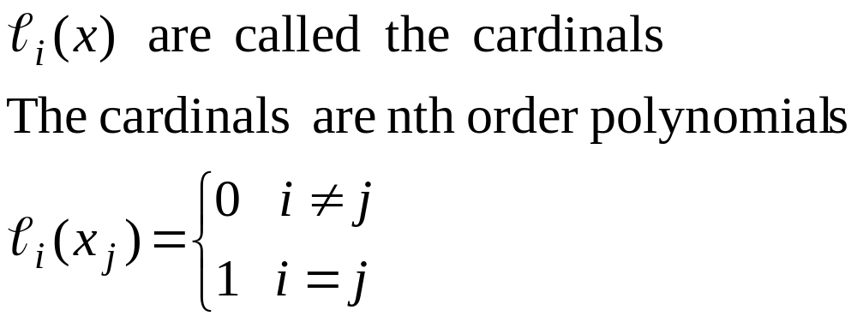
Lagrange Interpolation

Slide 14
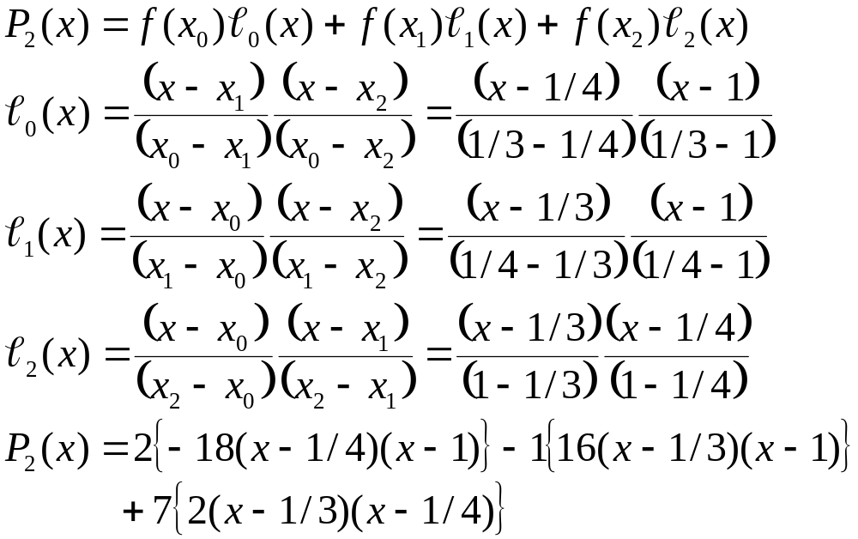
Lagrange Interpolation Example
x | 1/3 | 1/4 | 1
y | 2 | -1 | 7

Slide 15
Example
Find a polynomial to interpolate
The given data using Lagrange
Polynomial.
x | y
0 | 1
1 | 3
2 | 2
3 | 5
4 | 4

Slide 16
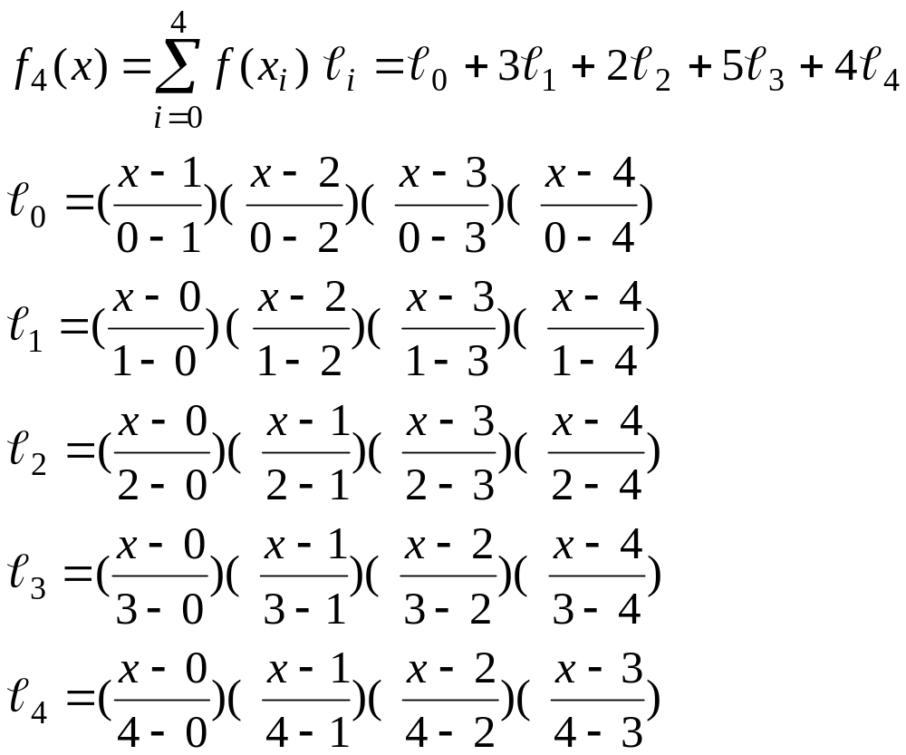
Interpolating Polynomial Using Lagrange Interpolation method

Slide 17
Example
Find a polynomial to interpolate the data.
x | f(x)
2 | 3
4 | 5
5 | 1
6 | 6
7 | 9

Slide 18
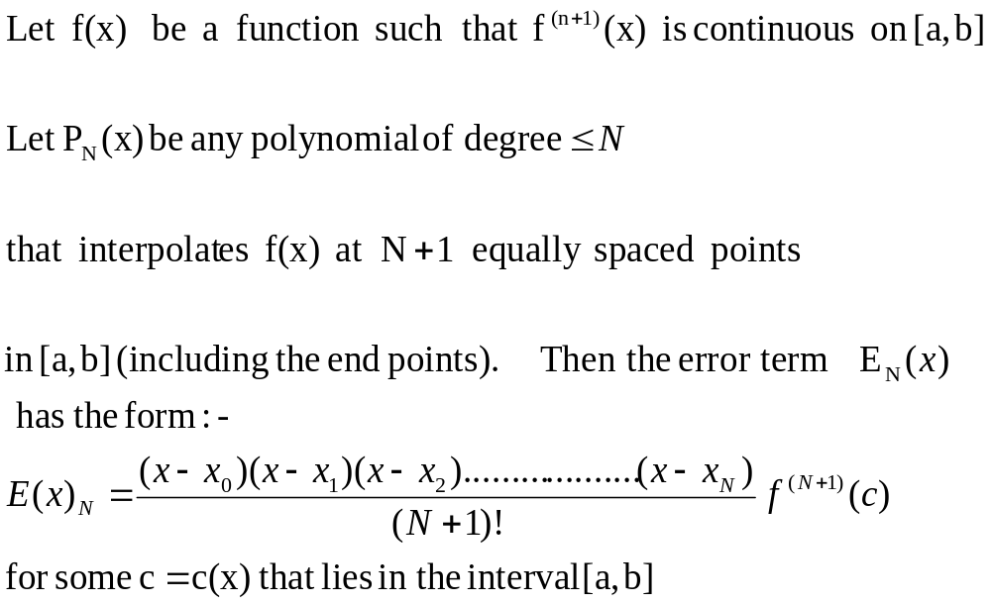
Errors Term in polynomial Interpolation

Slide 19
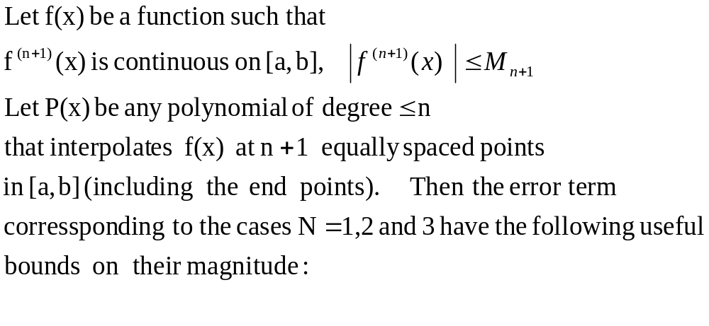
Errors Bounds in polynomial Interpolation

Slide 20
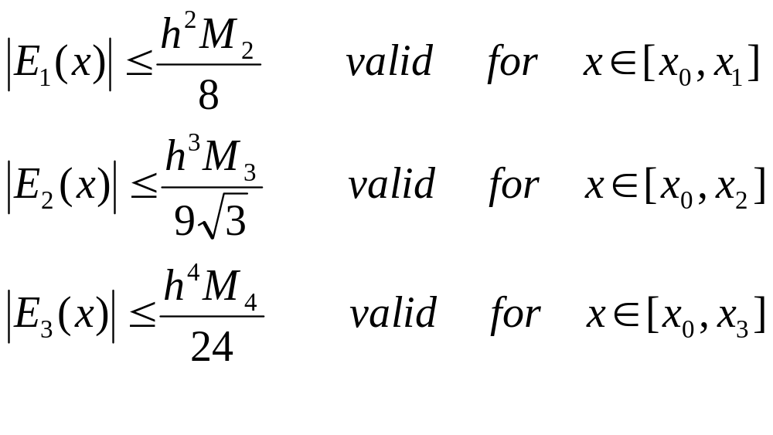
Error (bounds) in polynomial Interpolation

Slide 21
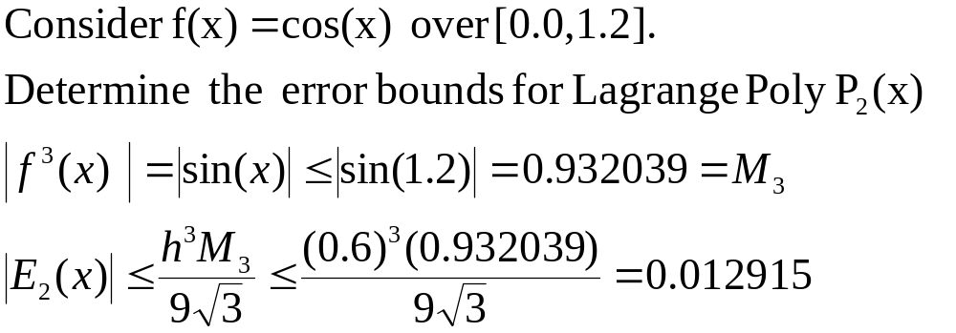
Error (bounds) in Lagrange polynomial Interpolation

Slide 22

Error Bounds - Example
Q# 10

Slide 23
A real # is represented by a machine using 32 bits and in compliance of IEEE 754. Find the number
1 | 1 | 1 | 1 | 0 | 0 | 0 | 1 | 0 | 1 | 1 | 1 | 0 | 0 | 0 | 0 | 0 | 0 | 0 | 0 | 0 | 0 | 0 | 0 | 0 | 0 | 0 | 0 | 0 | 0 | 0 | 0

Slide 24
LECTURE - 6

Slide 25
NEWTON INTERPOLATION

Slide 26
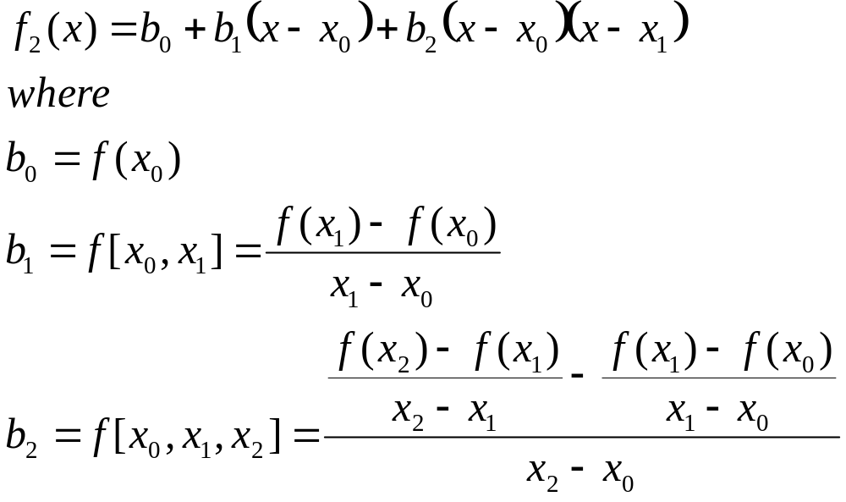
Quadratic Interpolation
Given any three points,
The polynomial that interpolates the three points is

Slide 27
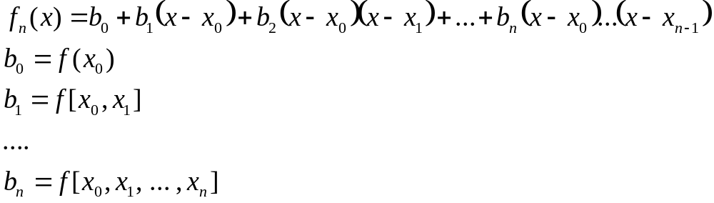
General n^{th} order Interpolation
Given any n+1 points,
The polynomial that interpolates all points is

Slide 28
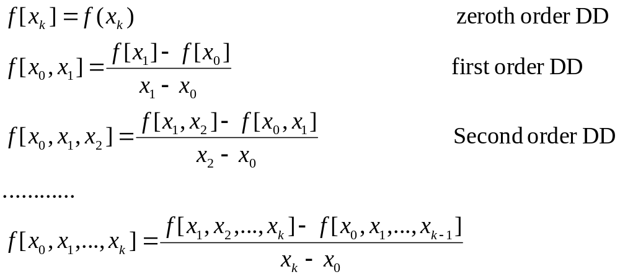
Divided Differences

Slide 29
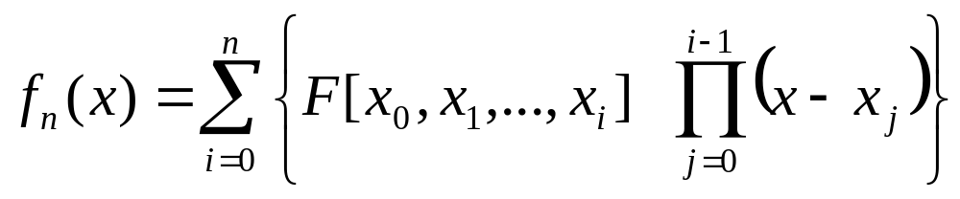
Divided Difference Table
x | F[ ] | F[ , ] | F[ , , ] | F[ , , ,]
x₀ | F[x0] | F[x₀,x₁] | F[x₀,x_{1,}x₂] | F[x₀,x₁,x₂,x₃]
x₁ | F[x₁] | F[x₁,x₂] | F[x₁,x₂,x₃]
x₂ | F[x₂] | F[x₂,x₃]
x₃ | F[x₃]

Slide 30

Divided Difference Table
x | F[ ] | F[ , ] | F[ , , ]
0 | -5 | 2 | -4
1 | -3 | 6
-1 | -15
 | f(x_{i})
0 | -5
1 | -3
-1 | -15
Entries of the divided difference table are obtained from the data table using simple operations

Slide 31
Divided Difference Table
x | F[ ] | F[ , ] | F[ , , ]
0 | -5 | 2 | -4
1 | -3 | 6
-1 | -15
 | f(x_{i})
0 | -5
1 | -3
-1 | -15
The first two column of the
table are the data columns
Third column : first order differences
Fourth column: Second order differences

Slide 32

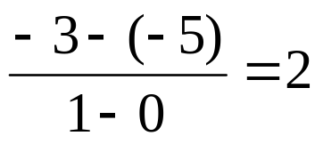
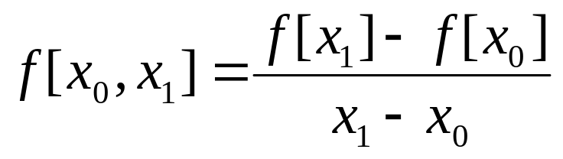
Divided Difference Table
0 | -5
1 | -3
-1 | -15
x | F[ ] | F[ , ] | F[ , , ]
0 | -5 | 2 | -4
1 | -3 | 6
-1 | -15

Slide 33
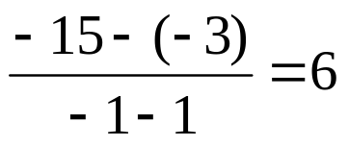
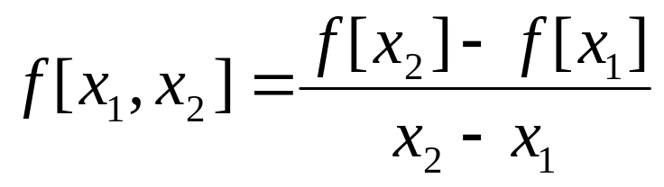
Divided Difference Table
0 | -5
1 | -3
-1 | -15
x | F[ ] | F[ , ] | F[ , , ]
0 | -5 | 2 | -4
1 | -3 | 6
-1 | -15

Slide 34
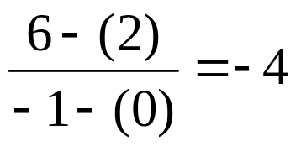
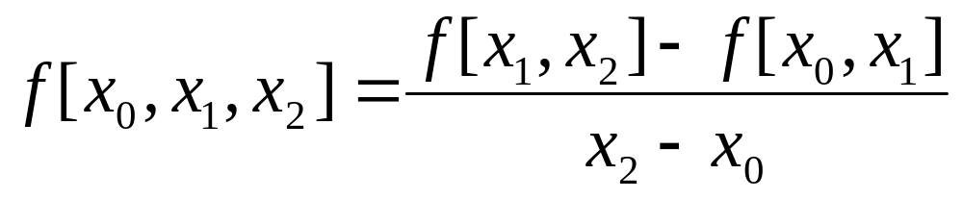
Divided Difference Table
0 | -5
1 | -3
-1 | -15
x | F[ ] | F[ , ] | F[ , , ]
0 | -5 | 2 | -4
1 | -3 | 6
-1 | -15

Slide 35
Divided Difference Table
0 | -5
1 | -3
-1 | -15
x | F[ ] | F[ , ] | F[ , , ]
0 | -5 | 2 | -4
1 | -3 | 6
-1 | -15
f₂(x)= F[x₀]+F[x₀,x₁] (x-x₀)+F[x₀,x₁,x₂] (x-x₀)(x-x₁)

Slide 36
Two Examples
Obtain the interpolating polynomials for the two examples
x | y
1 | 0
2 | 3
3 | 8
x | y
2 | 3
1 | 0
3 | 8
What do you observe?

Slide 37
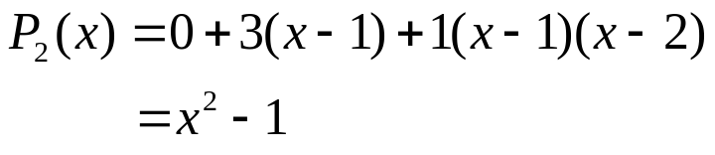

Two Examples
x | Y
1 | 0 | 3 | 1
2 | 3 | 5
3 | 8
x | Y
2 | 3 | 3 | 1
1 | 0 | 4
3 | 8
Ordering the points should not affect the interpolating polynomial

Slide 38
Properties of divided Difference
Ordering the points should not affect the divided difference

Slide 39
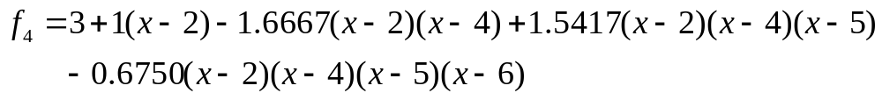
Example
x | f(x) | f[ , ] | f[ , , ] | f[ , , , ] | f[ , , , , ]
2 | 3 | 1 | -1.6667 | 1.5417 | -0.6750
4 | 5 | -4 | 4.5 | -1.8333
5 | 1 | 5 | -1
6 | 6 | 3
7 | 9

Slide 40
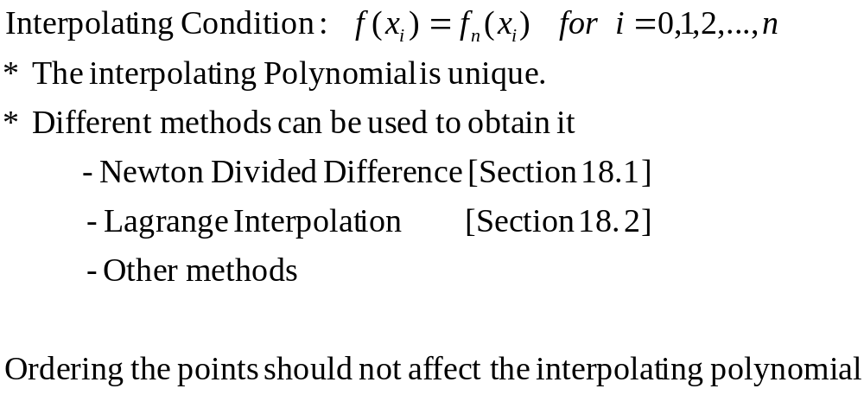
Summary

Slide 41
0 | 1 | 2 | -3/2 | 1/6 | -9/24
1 | 3 | -1 | 2 | -4/3
2 | 2 | 3 | -2
3 | 5 | -1
4 | 4

Slide 42
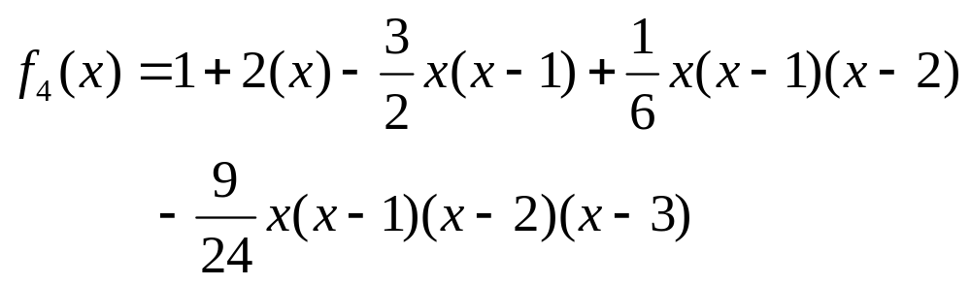
Interpolating Polynomial

Slide 43
SE301Numerical Methods
Lecture 16
Inverse interpolation
Error in polynomial interpolation
Dr. Samir Al-Amer
(Term 042)

Slide 44
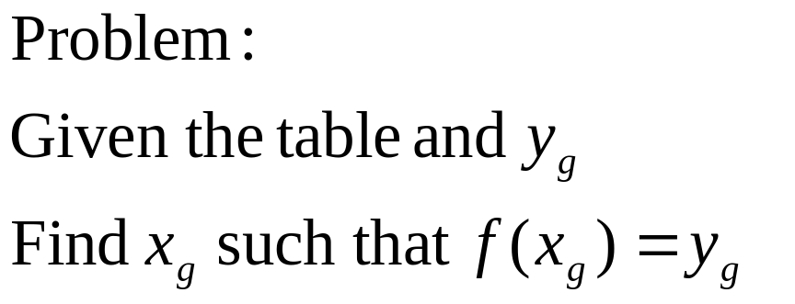

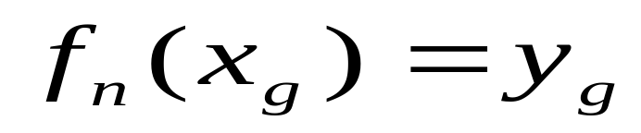
Inverse Interpolation
491
 |  |  | ….
 |  |  | ….
One approach:
Use polynomial interpolation to obtain f_{n}(x) to interpolate the data then use Newton’s method to find a solution to

Slide 45
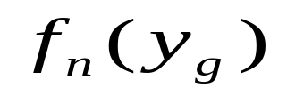
Inverse Interpolation
Alternative Approach
Inverse interpolation:
1. Exchange the roles
of x and y
2. Perform polynomial
Interpolation on the
new table.
3. Evaluate
 |  |  | ….
 |  |  | ….
 |  |  | ….
 |  |  | ….

Slide 46
Inverse Interpolation
x
y
x
y

Slide 47
Inverse Interpolation
Question:
What is the limitation of inverse interpolation
The original function has an inverse
y₁,y₂,…,y_{n} must be distinct.

Slide 48
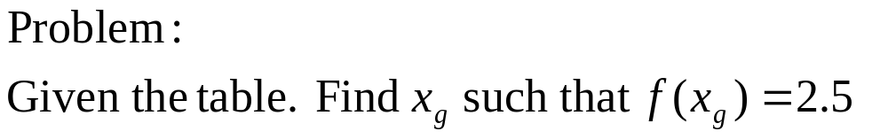
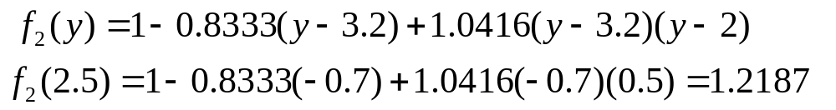
Inverse Interpolation
Example
x | 1 | 2 | 3
y | 3.2 | 2.0 | 1.6
3.2 | 1 | -.8333 | 1.0416
2.0 | 2 | -2.5
1.6 | 3

Slide 49
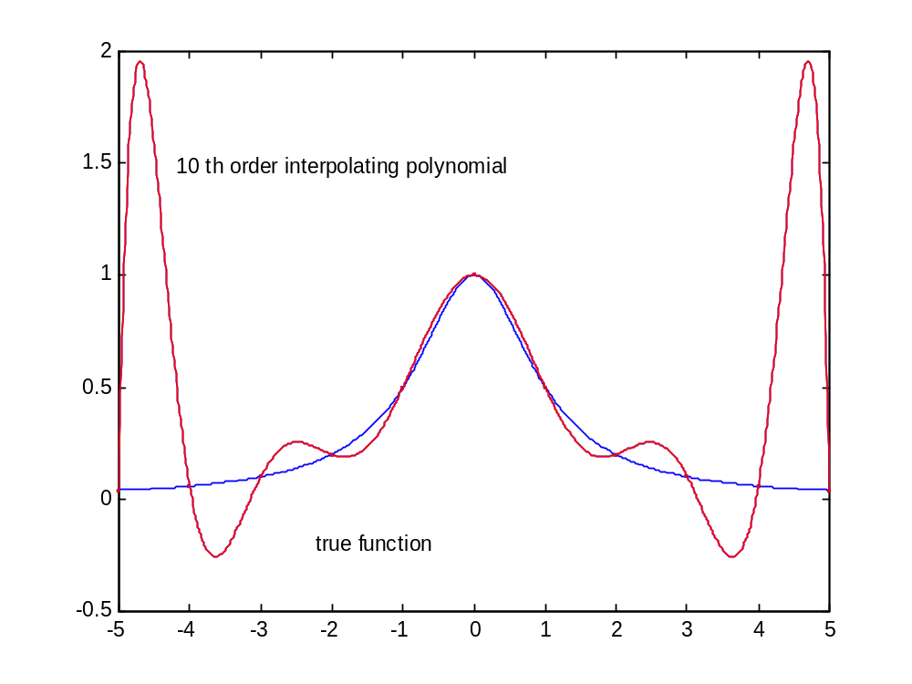
10 th order Polynomial Interpolation

Slide 50
Errors in polynomial Interpolation
Polynomial interpolation may lead to large error (especially for high order polynomials)
BE CAREFUL
When an nth order interpolating polynomial is used, the error is related to the (n+1) th order derivative

Slide 51
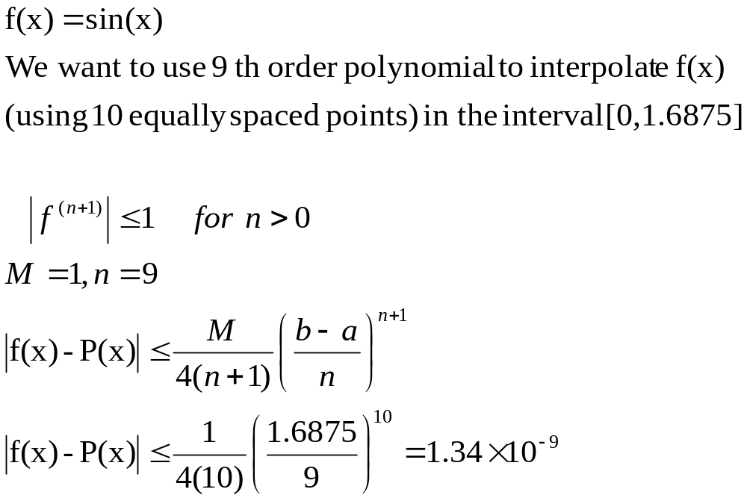
Example 1

Slide 52
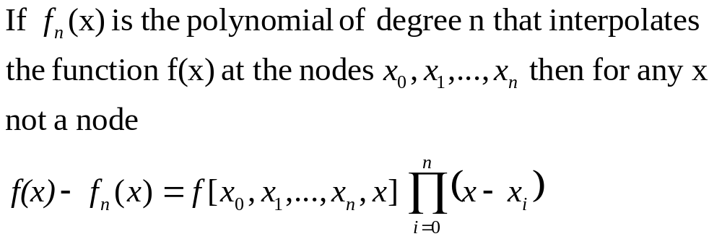
Interpolation Error
Not useful. Why?

Slide 53
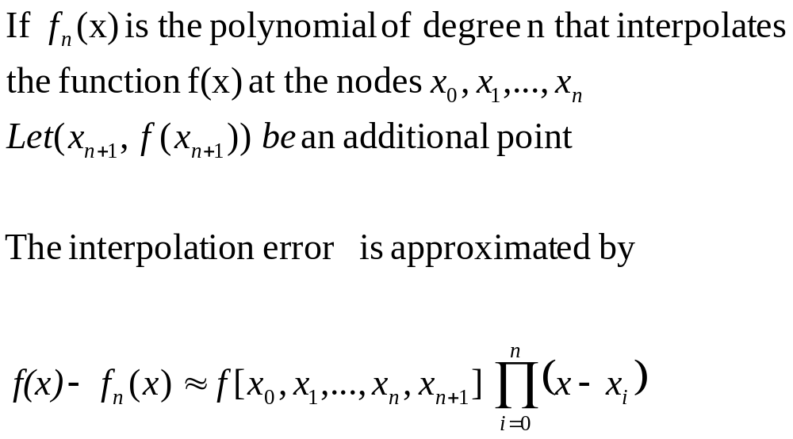
Approximation of the Interpolation Error

Slide 54
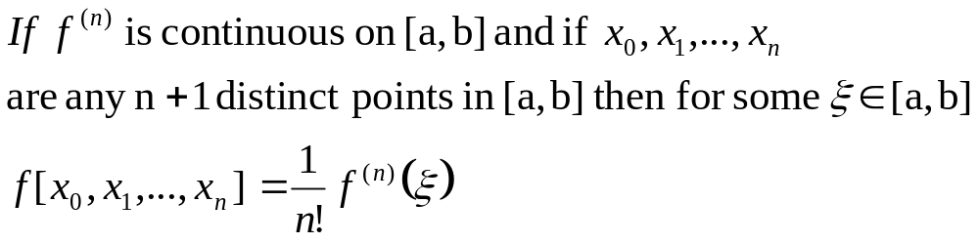
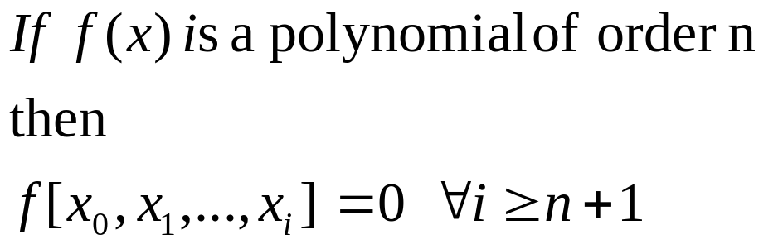

Divided Difference Theorem
1 | 4 | 1 | 0 | 0
2 | 5 | 1 | 0
3 | 6 | 1
4 | 7

Slide 55
Summary
The interpolating polynomial is unique
Different methods can be used to obtain it
  Newton’s Divided difference
  Lagrange interpolation
  others
Polynomial interpolation can be sensitive to data.
BE CAREFUL when high order polynomials are used

